Slide 1


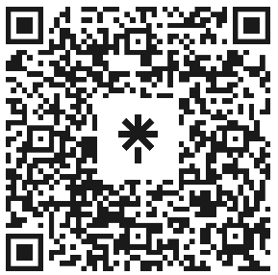

Introduction to Web Development
Attendance
linktr.ee/CODE.CRUNCH

Slide 2
Week #10
Enhancing Interactivity with DOM Manipulation and Event Handling

Slide 3
Introduction to the Week’s Topic
Overview: This week focuses on JavaScript DOM manipulation and handling events to create interactive web experiences. You'll learn how to dynamically modify the content and structure of a webpage using JavaScript.
Real-World Relevance:
Dynamic web pages rely on DOM manipulation to update content without refreshing the page.
Event handling allows user interactions (clicks, form submissions, etc.) to trigger JavaScript code, providing rich, responsive web apps.

Slide 4
Key Concepts for Today’s Lecture
Concepts Covered:
DOM Manipulation: Creating, updating, and deleting HTML elements dynamically.
Event Handling: Listening for and responding to user actions like clicks, mouse movements, and key presses.
Event Propagation: Understanding bubbling vs. capturing to control event flow.

Slide 5
What is the DOM?
DOM (Document Object Model):
The DOM is a hierarchical tree structure that represents the HTML or XML content of a webpage.
JavaScript can interact with this structure to dynamically change content, styles, and elements.
The DOM provides methods and properties for selecting, adding, deleting, and modifying elements.

Slide 6
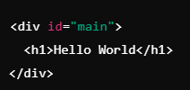


Slide 7
DOM Manipulation: Creating Element
Creating New Elements:
Use JavaScript to dynamically create new HTML elements.
Example: Creating a new <p> tag and adding it to the DOM.
Inserting Elements into the DOM:
You can use methods like appendChild(), insertBefore(), or replaceChild() to add, replace, or move elements within the DOM.

Slide 8
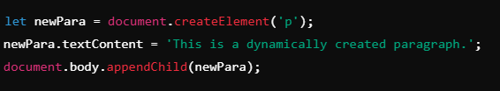

Slide 9
DOM Manipulation: Updating Content

Slide 10

Modifying Existing Elements
Text Content: Use textContent to change the text inside an element.
HTML Content: Use innerHTML to change the HTML content within an element.

Slide 11

Changing Attributes
You can modify attributes of elements, like src, href, or class.

Slide 12

DOM Manipulation: Removing Elements
Removing Elements:
Use remove() or removeChild() to delete elements from the DOM.

Slide 13
Event Handling in JavaScript
What is an Event?
An event is an action that occurs as a result of user interaction or browser behavior (clicks, key presses, mouse movements).
Event Listeners:
JavaScript allows you to listen for events using addEventListener() method.
Example: Add a click event to a button

Slide 14
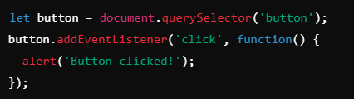

Slide 15
Types of Events
Common Event Types:
Mouse Events: click, dblclick, mousemove, mouseenter
Keyboard Events: keydown, keyup, keypress
Form Events: submit, focus, blur, change
Window Events: load, resize, scroll

Slide 16
Event Propagation: Capturing vs. Bubbling
Event Propagation:
When an event occurs, it doesn’t only affect the element that the event was triggered on, but can also affect its ancestors in the DOM tree.
Event Bubbling:
Bubbling happens when an event starts from the innermost element (where it was triggered) and propagates outward to its parent elements.
Event Capturing:
Capturing is the reverse of bubbling. It starts from the root of the document and propagates down to the target element.

Slide 18
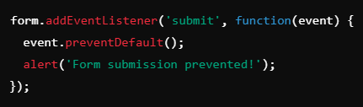
Preventing Default Behavior
preventDefault():
You can use preventDefault() to stop the default behavior of an event (e.g., preventing a form from submitting).

Slide 19
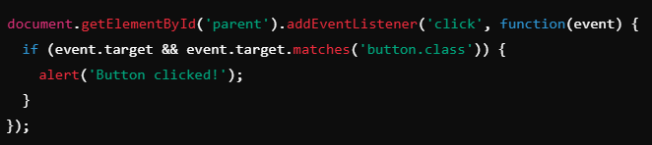
Best Practices for Event Handling
Use Event Delegation: Instead of adding event listeners to every individual element, attach a listener to a common parent element and use event delegation to catch events on child elements.

Slide 20
Real-World Example
Case Study: A photo gallery where clicking on a thumbnail dynamically updates the larger image.
DOM Manipulation: Changing the src attribute of an <img> element based on user interaction.
Event Handling: Using click events to update the image dynamically without reloading the page.

Slide 21
Summary of Key Points
DOM Manipulation: You can dynamically create, update, and remove elements using JavaScript.
Event Handling: Use addEventListener() to respond to user interactions, and understand event propagation (bubbling vs. capturing).
Event Delegation: Improve performance by delegating events to a parent element.

Slide 22
Coding Lab

Slide 23
Introduction to the Coding Lab
Objective: In this lab, you will enhance the interactivity of your website using JavaScript.
Focus on DOM manipulation and event handling.
Tasks include adding form validation, providing user feedback, and dynamically updating content based on user input.

Slide 24
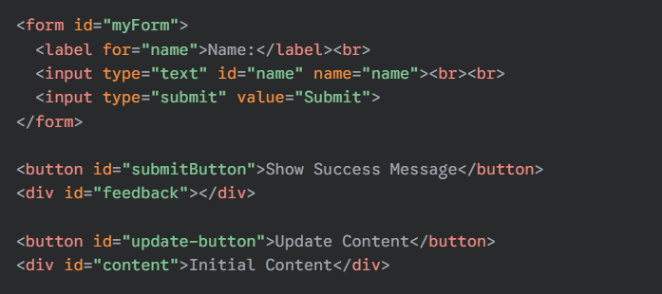
Task 0 - Setup HTML

Slide 25
Task 1 - Create a Dynamic Form Validation
Objective: Add a form to your webpage and use JavaScript to validate user input.
Use input elements for text and email fields.
Use JavaScript to ensure fields are filled out correctly before submission.

Slide 26
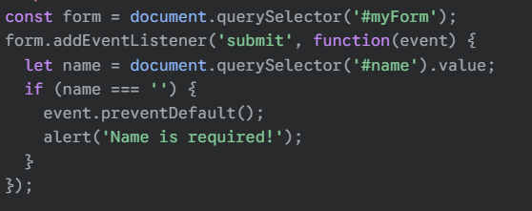

Slide 27
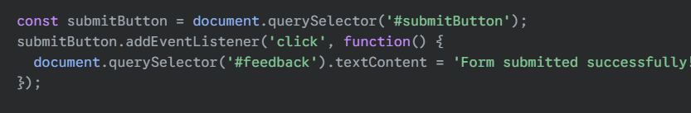
Task 2 - Provide User Feedback
Objective: Show feedback when a user interacts with a form or clicks a button.
Change the color of a button when clicked.
Display a success message when form validation passes.

Slide 28
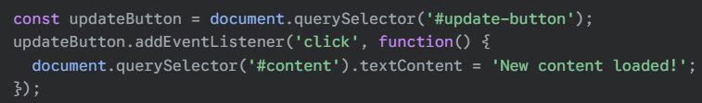
Task 3 - Update Content Dynamically
Objective: Use JavaScript to update the content on your page based on user actions.
Change the text of a paragraph when a button is clicked.
Dynamically load additional content, like an image or a list of items.

Slide 29
Final Project Instructions

Slide 30
Define Your Project Idea
Think about something you want to build that incorporates HTML, CSS, and JavaScript. Here are some ideas to get you started:

Slide 31
Project Ideas
Personal Portfolio Website: A clean, stylish site that highlights your projects, skills, and a bit about you. Add sections like About Me, Contact, and Project Showcase.
Interactive To-Do List: Build a task manager where users can add, delete, and mark tasks as completed. Add local storage so tasks persist even after a page refresh.
Weather App: Create an app that fetches weather data from an API and displays it beautifully. You could even add forecast functionality and cool CSS animations for dynamic updates.
Interactive Quiz Game: Build a fun quiz with multiple-choice questions. Keep score, show feedback for correct/incorrect answers, and add a timer for added challenge.
Blog or Article Website: Build a responsive blog layout where users can filter content based on categories (using JavaScript to toggle between different articles).
Interactive Image Gallery: A gallery where users can click on images to enlarge them or add a lightbox effect.
Landing Page for a Business or Product: Create a sleek landing page with sections for product features, testimonials, and a call to action (like a contact form or newsletter sign-up).

Slide 32
Final Touches
As you near completion, focus on these finishing touches:
Polish Your Design: Ensure everything is visually appealing and cohesive. Adjust margins, paddings, and colors for readability and flow.
Documentation: Add a README file to your project repository (GitHub). Include:
A project description.
Technologies used.
Instructions for running the project.
Deployment: Deploy your project to a hosting platform like Vercel so it’s live and accessible for your demo.

Slide 33
GitHub Setup
Create a GitHub Account: Go to GitHub and sign up for a free account.
Install Git: Download and install Git from https://git-scm.com.
Initialize Git in VS Code: Open VS Code, then open your project folder.
Create a New Repository: On GitHub, click New Repository, name it, and click Create Repository.
Link Local Repo to GitHub: Add the remote URL from GitHub:
Push Code to GitHub:
Push your code to the GitHub repository

Slide 34
Deploy to Vercel
Sign Up on Vercel: Go to Vercel and sign up with GitHub.
Link Your GitHub Repo: After signing in, click New Project and select the GitHub repository you want to deploy.
Vercel Deployment Setup: Vercel automatically detects your project settings (e.g., React, Next.js, static sites) and prepares your project for deployment.
Deploy: Click Deploy. Vercel will build and deploy your project live, providing you with a unique URL (e.g., https://your-project-name.vercel.app).

Slide 35
Good Luck!
Your Final Project is the culmination of everything you’ve learned. This is your chance to showcase all the skills you’ve developed throughout the course. So get creative, have fun, and be proud of the work you’ve done. Demo Day will be an exciting opportunity to share your hard work and receive feedback to continue improving. You’ve got this! 🎉🚀

Slide 36
Q & A Session

Slide 37
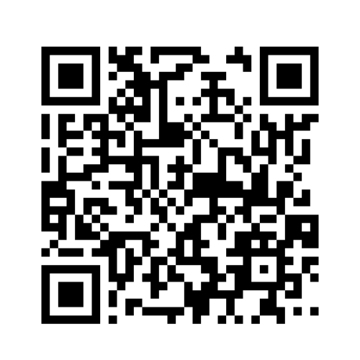
https://github.com/CODE-CRUNCH-CLUB/C8-CRUNCH-LABS-WEB-DEV

Slide 38





Attendance
Join us for the next sessions
Check our schedule on Discord “Schedule” Channel
RSVP lu.ma/CODECRUNCH
Your feedback helps us improve. Share your thoughts! Go to our website: go.fiu.edu/codecrunch
linktr.ee/CODE.CRUNCH

